Slide 1
Authoring and Publishing PowerShell Scripts and Modules

Slide 2
Attention
MMS sessions are 60-75 minutes followed by LONG Q&A
Please hold detailed questions until that Q&A starts
Feel free to ask clarification questions
Remind the speakers to use Zoom It when you can’t see

Slide 3

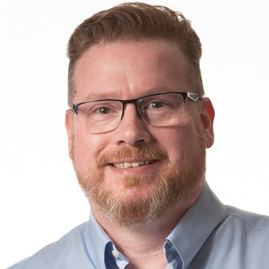


David Segura, MVP
Travis Roberts
Recast Software
ciraltos.com
davidsegura
in/davidsegura
tsrob50@gmail.com
in/robertst

Slide 4
Getting Started

Slide 5
VS Code Configuration

Slide 6
Best Practices

Slide 7
Script Requirements for PowerShell Gallery

Slide 8
Module Requirements for PowerShell Gallery

Slide 9
Using GitHub for Source Control

Slide 10
Using GitHub for Source Control

Slide 11
PowerShell Module Framework

Slide 12
Testing Scripts and Modules

Slide 13
Module Types

Slide 14
Wrap-Up

Slide 15
Welcome
Don’t be shy
We won’t talk about the Society for Critical Care Medicine
Long live … Intune?
Use Zoom It
My Data | Day | Week
123 | 3 | M
456 | 5 | W
789 | 7 | F

Slide 16
How to win at life
According to Brian

Slide 17
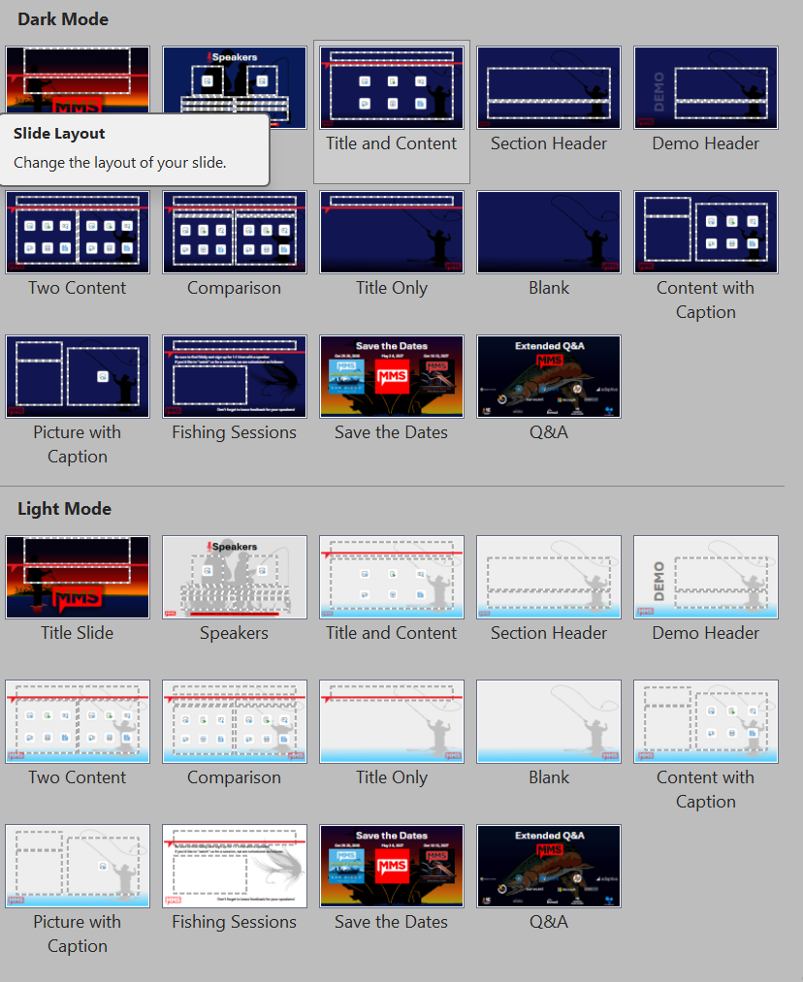
Don't Cross The Streams!
New for this year: LIGHT MODE
Use one or the other; NOT BOTH.
Session Title, Save the Dates, and Q&A are the same regardless of mode.

